Slide 1
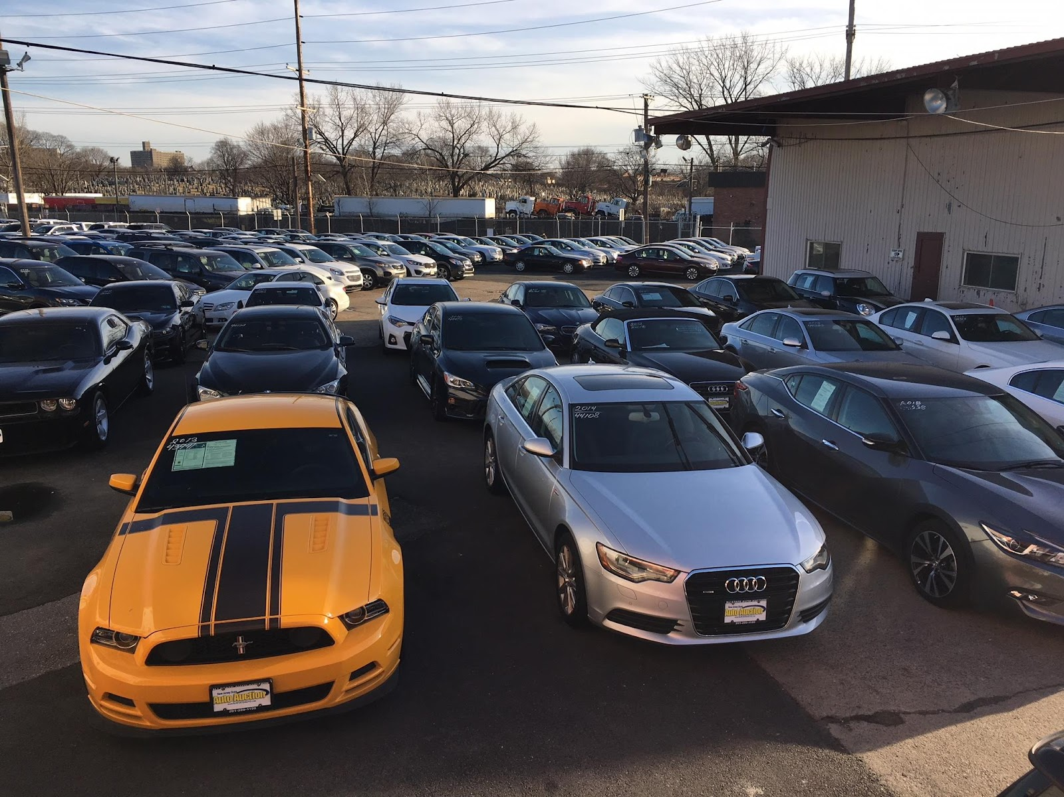
Predicting the resale value of cars using Machine Learning in Pyspark

Slide 2



Team 7
Shourya Chouhan Majors: BI&A Indore,India
Aditya Nair Majors: BI&A Mumbai, India
Dinesh Giri Majors: BI&A Bhubaneswar , India

Slide 3
Overview
Introduction
Data description
Exploratory data analysis
Data preparation and pre processing
Imputation
Encoding
Models
Random forest
Gradient boosted tree
Linear Regression
Evaluation
Conclusion

Slide 4
Introduction
Sometimes selling your used car becomes crucial as we are not able to identify its fair price accurately. The depreciation of a car depends on a variety of factors so the car owner needs to be aware of the worth of their vehicle.
With the rapid expansion of Machine Learning, this problem can also be solved by minimizing human efforts and time. Let’s see an end-to-end solution for a similar problem.

Slide 5
Data description
The dataset used for the purpose of this report was downloaded from https://www.kaggle.com/datasets/austinreese/craigslist-carstrucks-data
The data set consist of 4.5L Rows & 26 columns.
Some of the features used to predict the price are year , Region , Manufacturer , Model , Cylinder , Fuels , odometer , Transmission , Size Type , Paint Color & Description.

Slide 6
Performance Metrics
We shall be evaluating 3 machine learning techniques in this paper -
Linear Regression
GBT regressor
Random Forest
The evaluation of the machine learning models shall be done on the basis of -
Mean Absolute Error (MAE)
Root Mean Absolute Error (RMSE)
R2 score

Slide 7
Evaluation Metrics
Root Mean squared error -RMSE is a measure of how spread out these residuals are. In other words, it tells you how concentrated the data is around the line of best fit.
R2(coefficient of determination) regression score function- is a statistical measure that represents the proportion of the variance for a dependent variable that's explained by an independent variable or variables in a regression model.Best possible score is 1.0 and it can be negative (because the model can be arbitrarily worse).
Mean absolute error -the mean absolute error of a model is the mean of its absolute values for each of the prediction error i.e. individual prediction error over all the instances of the test set.

Slide 8

Exploratory Data Analysis
Firstly, we remove the following features from our data, as they were not adding much information/value to the data -
URL
Region_url
Vehicle identification number
Image_url
Ad_posting_date
Notes:
First point - Before actually getting into the data analysis, it is important for us to understand our data and what is the value that is actually added by the features to our output.

Slide 9
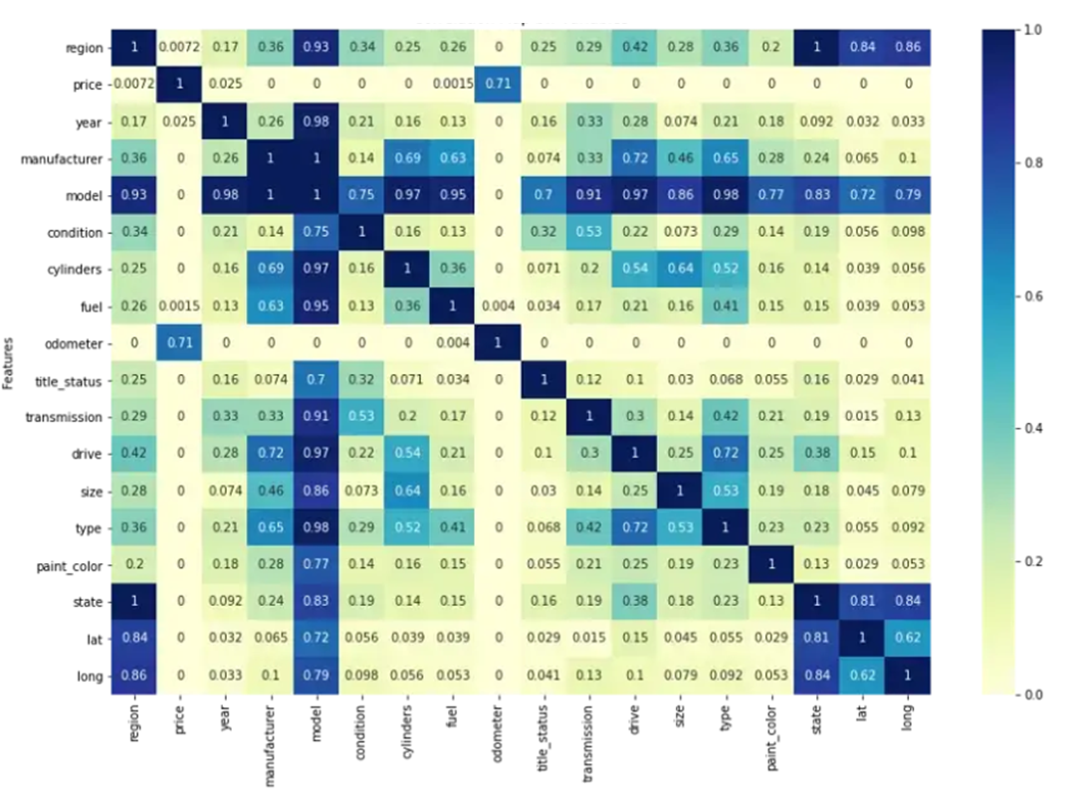
Exploratory Data Analysis
We now plot a heatmap of the correlation matrix - to understand the correlation between each of the variables using Phi_k correlation analyzer library.
Odometer has a correlation of 0.7 with price, making odometer an imp. feature
Model seems to be highly correlated with most of the variables, hence it is not considered to be very important wrt. price
Notes:
First point - as the title suggests, we are interested in predicting the price of the vehicle, therefore Price is the most important feature for us.
Therefore , let us now understand how price is related to the other features in our dataset which are of importance when it comes to predicting the resale value of the cars

Slide 10
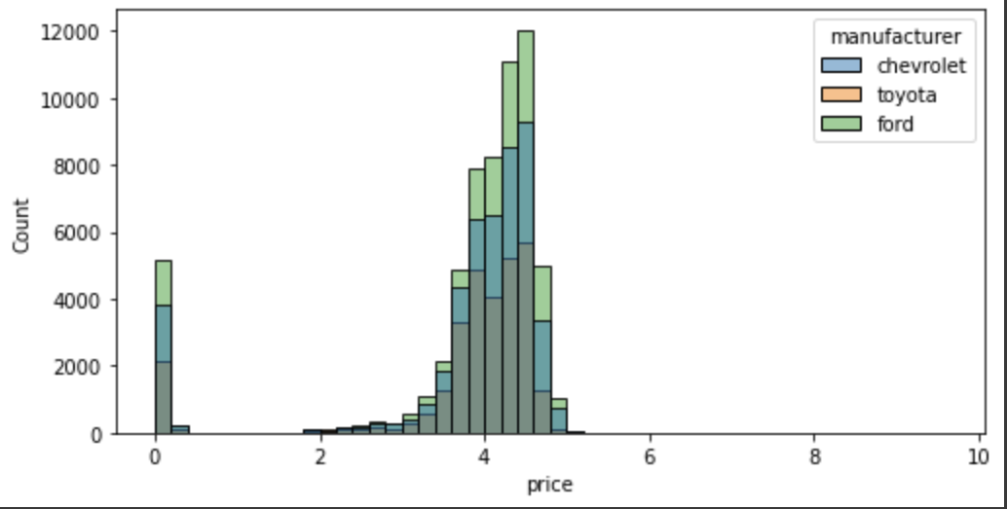
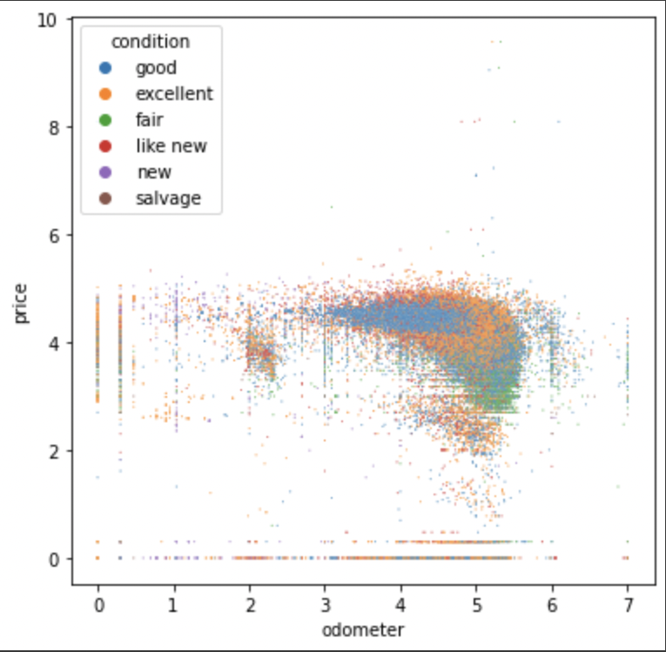
Exploratory data analysis

Slide 11
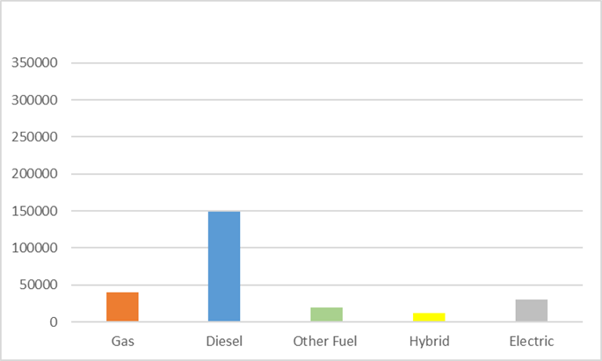
Exploratory Data Analysis
Price vs Fuel Type -
We see that Diesel cars are the most expensive in the US market.
Cars with other fuel types are seen to have lesser price
Therefore, we can see that Fuel type in a car does affect the price of the vehicle and is an important feature
Notes:
First point - We now look at price vs some other features

Slide 12
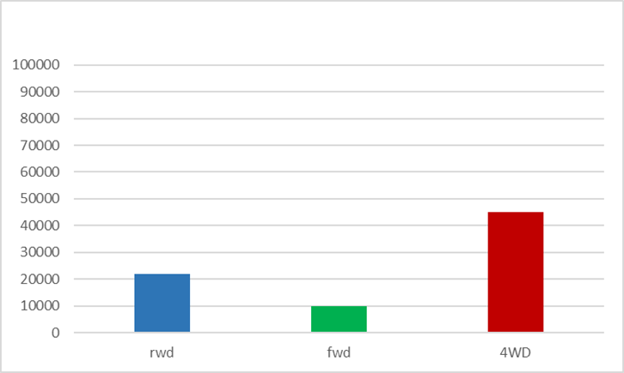
Exploratory Data Analysis
Price vs Drive Type -
4WD cars are the most expensive in the US market, followed by the RWD and FWD drive types.
Since , there is a difference between the prices of cars across drive type, therefore we see that Drive type is also an important feature.

Slide 13
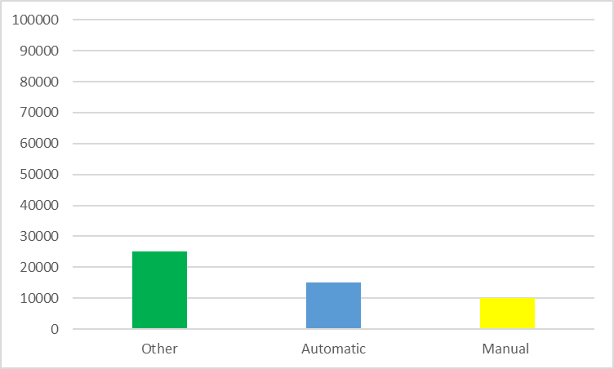
Exploratory Data Analysis
Price vs Transmission Type -
Most of the Automatic and Manual vehicles are seen to be below $20K
On the other hand, vehicles having a different transmission type are seen to be more expensive.
Hence, we see that even Transmission type is an important feature when it comes to predicting the price of the vehicle

Slide 14
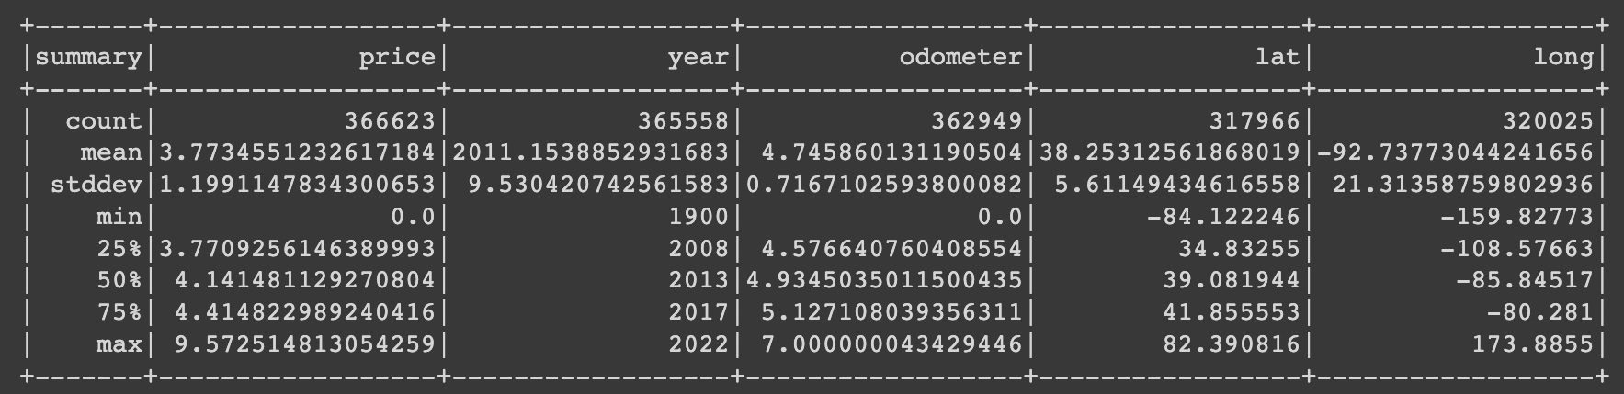
Data wrangling
price" and "odometer" columns have right skewed distribution (mean is bigger than median)
"price" and "odometer" columns have too big numbers and too much standard deviation, we can take the log of them
"posting_date" column can be split to "posting_year", "posting_month"
Notes:
Data wrangling is the process of removing errors and combining complex data sets to make them more accessible and easier to analyze.
From the data, it was understood that …

Slide 15
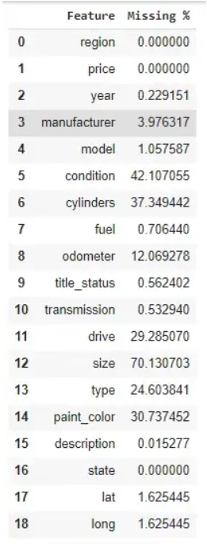
Data Cleaning
The feature - Size is removed from our analysis as 70% of the values are null. Similarly we remove any feature who has a null % of over 50%.
Due to high correlation with region, we have removed the features State, latitude and longitude from the analysis
Outliers like - price less than $200, vehicle from before 1950, vehicles clocking 0 miles have been removed from the data.
Null values in other features have been either filled using domain knowledge or simply filled using the mode value of that column/feature.

Slide 16
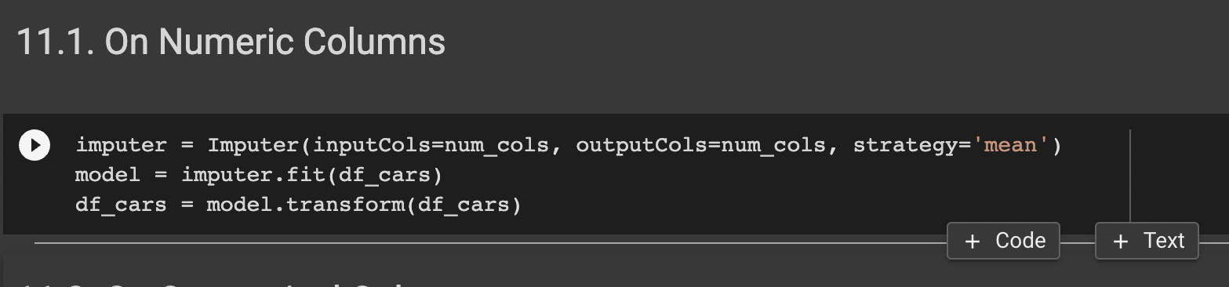
Imputation
Imputation estimator for completing missing values, using the mean, median or mode of the columns in which the missing values are located. The input columns should be of numeric type.

Slide 17
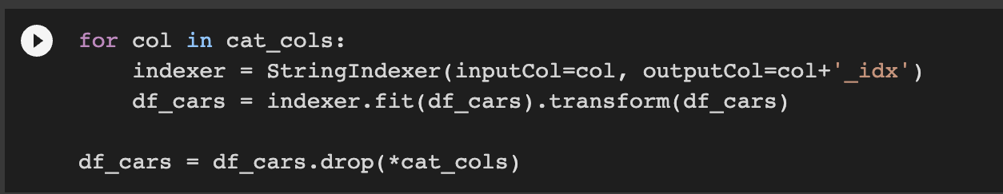
Using String Indexer for categorical column encoding
Encoding categorical data is a process of converting categorical data into integer format so that the data with converted categorical values can be provided to the different models.
A label indexer that maps a string column of labels to an ML column of label indices. If the input column is numeric, we cast it to string and index the string values.
Notes:
\

Slide 18
Runtime of different models in Google collab
Random forest : 6mins using cpu
2 mins using gpu
Linear regression: 3 mins
GBT : 5 mins

Slide 19
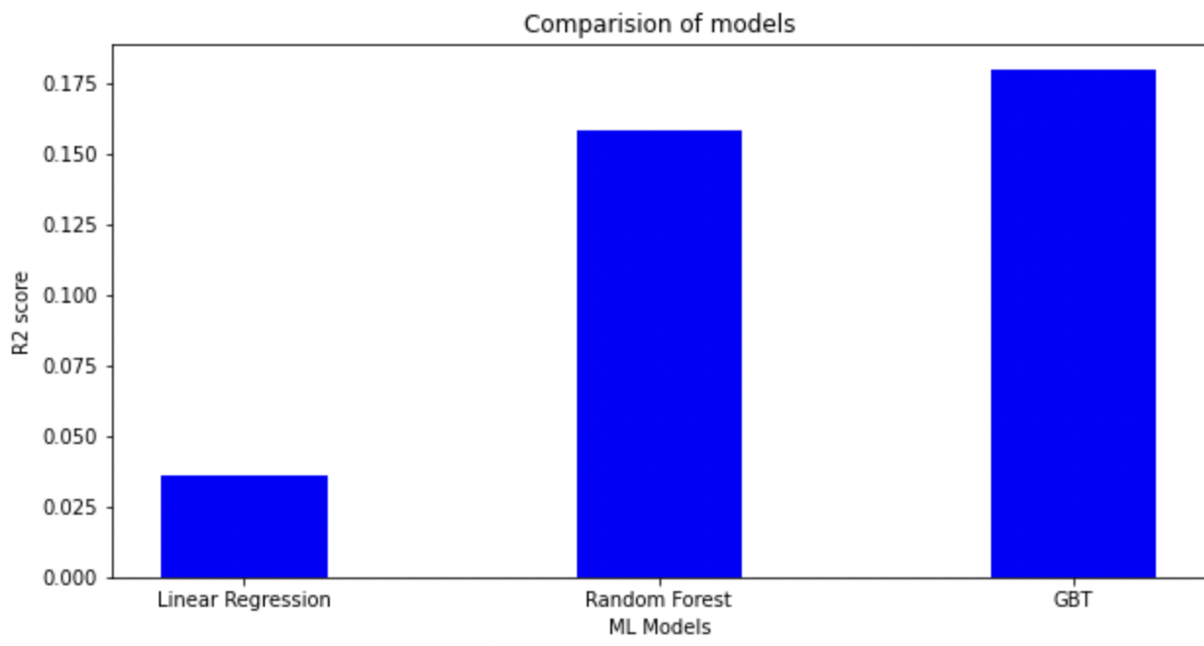
Evaluation of models using regression evaluator
Models/metrics | RMSE | MAE | R2
Random Forest | 1.1038 | 0.6578 | 0.1578
GBT | 1.0894 | 0.6534 | 0.1796
Linear Regression | 1.1811 | 0.7306 | 0.0357

Slide 20
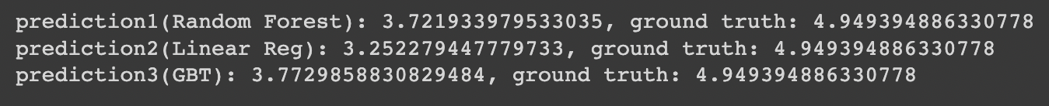
Single Sample Prediction

Slide 21
Conclusion
GBT has the least MAE score of 0.6534 out of all the models
The sample prediction of GBT model is also the closest to the actual value
Therefore,GBT regression has the best accuracy followed by random forest and linear regression

Slide 22
Future Scope
Applying more regression models like xGboost regression, Ada boost and custom stacking regressor to get better accuracy
Using ensemble modelling
Increasing the depth of GBT
We plan to utilize Deep Neural Networks to improve our prediction performance while avoiding overfitting. In addition to this, we shall tune Decision-Tree parameters like the number of trees, depth, etc. and sub-sample datapoints.

Slide 23
References
1.https://www.kaggle.com/jpayne/852k-used-car-listings
2. N. Monburinon et al "Prediction of prices for used car by using regression models," ICBIR 2O18, Bangkok, 2O18, pp. 115-119.
3. Listiani M. 2OO9. Support Vector Regression Analysis for Price Prediction in a Car Leasing Application. Master Thesis. Hamburg University of Technology

Slide 24
Thank you

